Slide 1
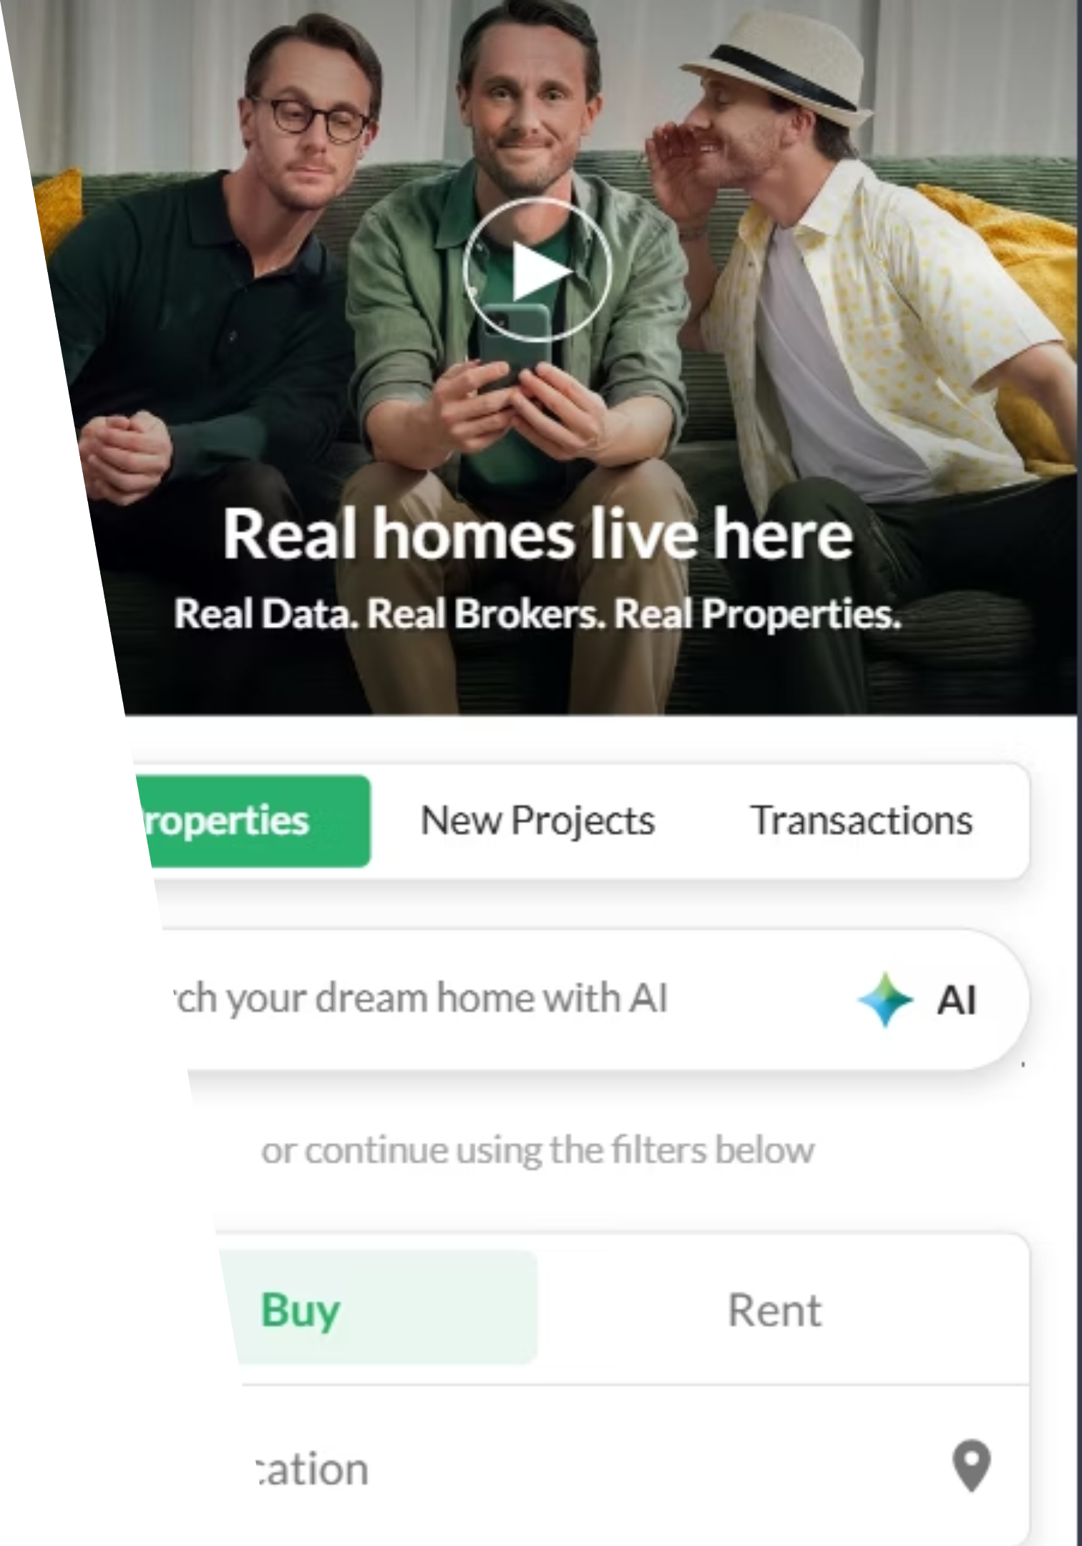
Software Testing of Bayut.com
Semester Project: Software Testing Course
Uswa Zainab, Wareesha Khawar, Arshah Lafees, Talal Jamil

Slide 2
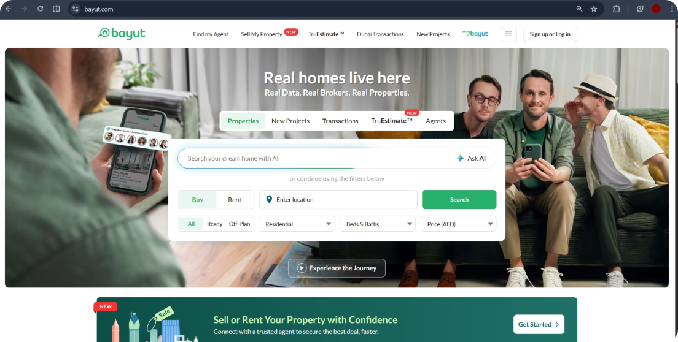
What is Bayut?
UAE's #1 Property Platform
Bayut is the leading property search platform in the UAE, allowing users to search, buy, and rent properties across the country. Available on both Web and Mobile (iOS & Android), it serves millions of users with a rich set of features.
🔍 Search Filters
🗺️ Map View
📞 Agent Contact
🧮 Mortgage Calculator

Slide 3

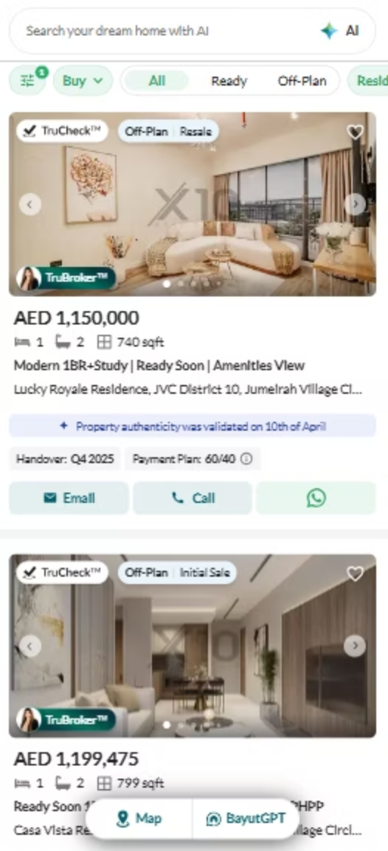
Why We Chose Bayut
Real-World Application
A live platform with multiple complex features to test — providing authentic testing scenarios beyond classroom examples.
Feature Variety
Forms, filters, login, and a mortgage calculator offer a rich variety of elements ideal for applying different testing techniques.
High User Impact
Used by millions of people across the UAE — software quality directly affects real users, making testing critically important.
Full Coverage
Bayut covers all testing levels studied in class — from unit-level logic to full system-level integration.

Slide 4
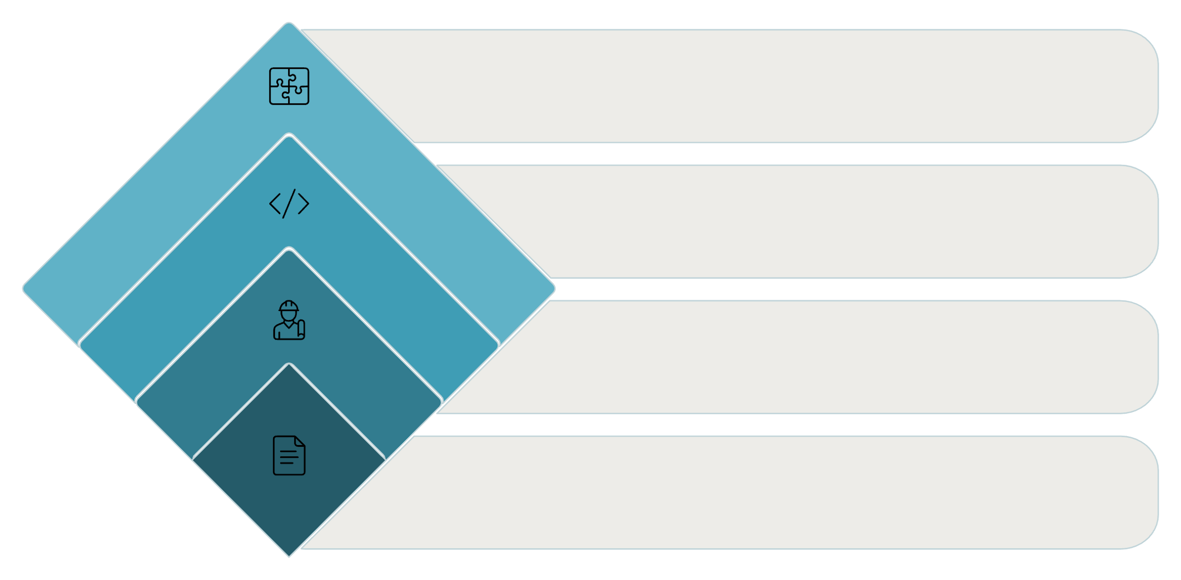

Testing Strategy
We followed a structured approach covering all testing levels — starting from the unit level and moving up to the system level. We used both White-box and Black-box techniques, and all testing was performed manually.
Integration
Combine modules
Implementation
Develop components
Design
Architect modules
Requirements
Define system needs
This V-Model approach ensures that every development phase has a corresponding testing phase, providing comprehensive coverage from the smallest units up to the complete system.

Slide 5
White Box Testing: Mortgage Calculator
Approach
CFG Nodes & Edges
We selected the Mortgage Calculator feature for white-box testing. A Control Flow Graph (CFG) was drawn for the calculation logic, and Cyclomatic Complexity was calculated to determine the minimum number of test cases required.
01
Start
02
Validate Input
03
Calculate EMI
04
Show Result → End
Edges: 4 | Nodes: 4 | V(G) = 3
Cyclomatic Complexity
Test Cases Derived
V(G) = E − N + 2
= 4 − 4 + 2 = 3
3 independent paths identified → 3 test cases designed to cover all execution paths.

Slide 6
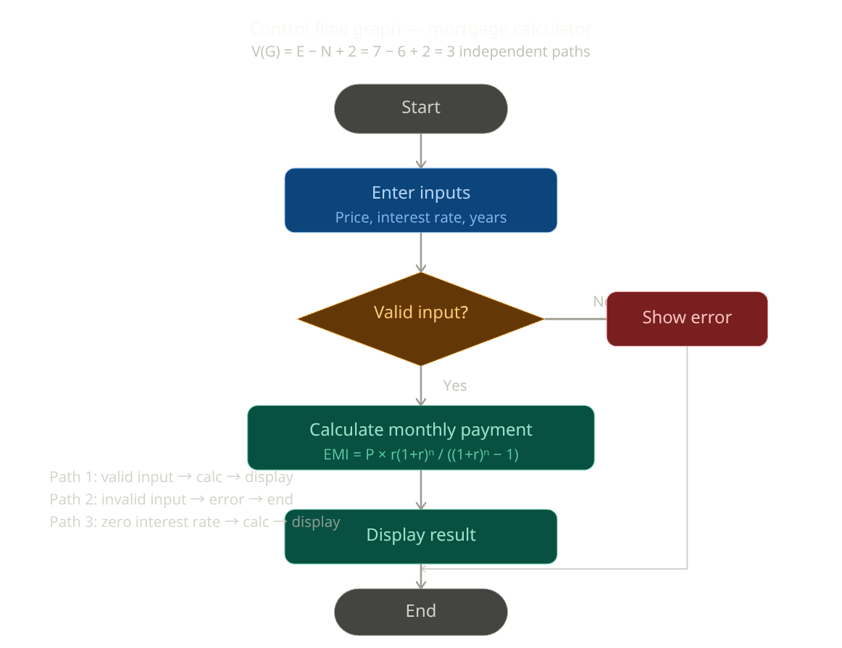
Control Flow Graph: Mortgage Calculator
The CFG below maps all possible execution paths through the mortgage calculator logic. Three independent paths were identified for test case design.
Path Descriptions
1
Path 1 — Valid Input
User enters valid price, rate, and years → EMI is calculated and result is displayed.
2
Path 2 — Invalid Input
User enters invalid or missing data → Error message is shown and process ends.
3
Path 3 — Zero Interest Rate
Edge case where interest rate = 0 → Calculator handles division and displays result correctly.

Slide 7
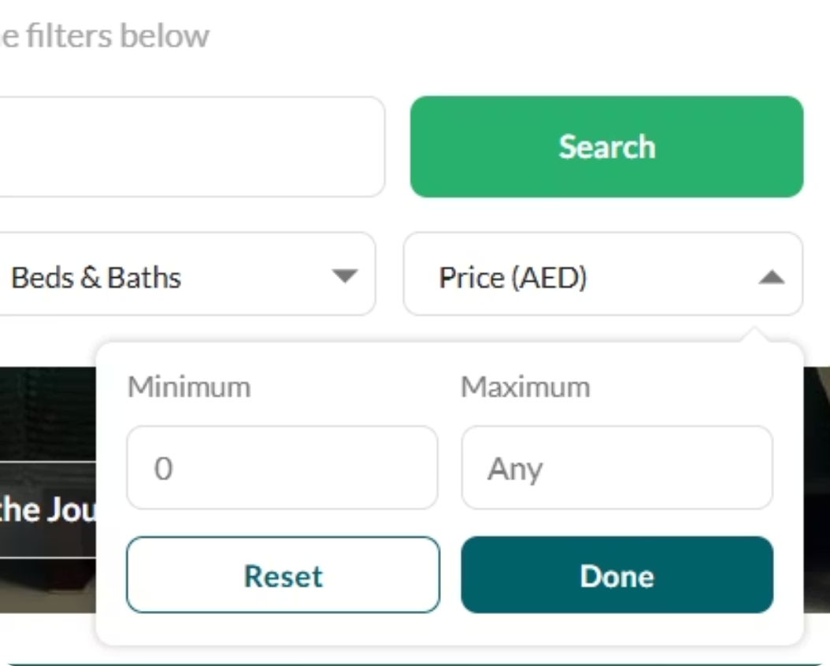

Black Box Testing: Equivalence Class Partitioning
Applied to the Price Filter on Bayut's property search. Input values were grouped into equivalence classes — valid ranges that should behave the same, and invalid ranges that should be rejected.
Class
Input
Valid / Invalid
EC1
50,000 – 10,000,000 AED
✅ Valid
EC2
−500 (negative value)
❌ Invalid
EC3
"abc" (text input)
❌ Invalid
EC4
0 (zero value)
❌ Invalid
One representative test case from each class is sufficient to cover the entire class, reducing the total number of tests while maintaining coverage.

Slide 8

Black Box Testing: Boundary Value Analysis
Applied to the Bedroom Filter (Studio, 1, 2, 3, 4, 5+). Boundary values were tested at the edges of each partition to catch off-by-one errors and edge-case behavior.
Test Case
Input
Expected
Actual / Result
TC1
0 (Studio)
Show studio listings
App showed blank → ❌ Fail
TC2
1
Show 1-bed listings
Correct → ✅ Pass
TC3
5
Show 5-bed listings
Correct → ✅ Pass
TC4
6+
Show 6+ listings
Correct → ✅ Pass
Key Finding: TC1 revealed a defect: selecting "Studio" (0 bedrooms) returns a blank result instead of studio listings. This is a boundary condition bug that should be reported to the development team.

Slide 9
Black Box Testing: Decision Table
Applied to: Login Feature
Condition
Case 1
Case 2
Case 3
Case 4
Email valid
✅
✅
❌
❌
Password valid
✅
❌
✅
❌
Result
Login ✅
Wrong pass ❌
User not found ❌
User not found ❌

Slide 10



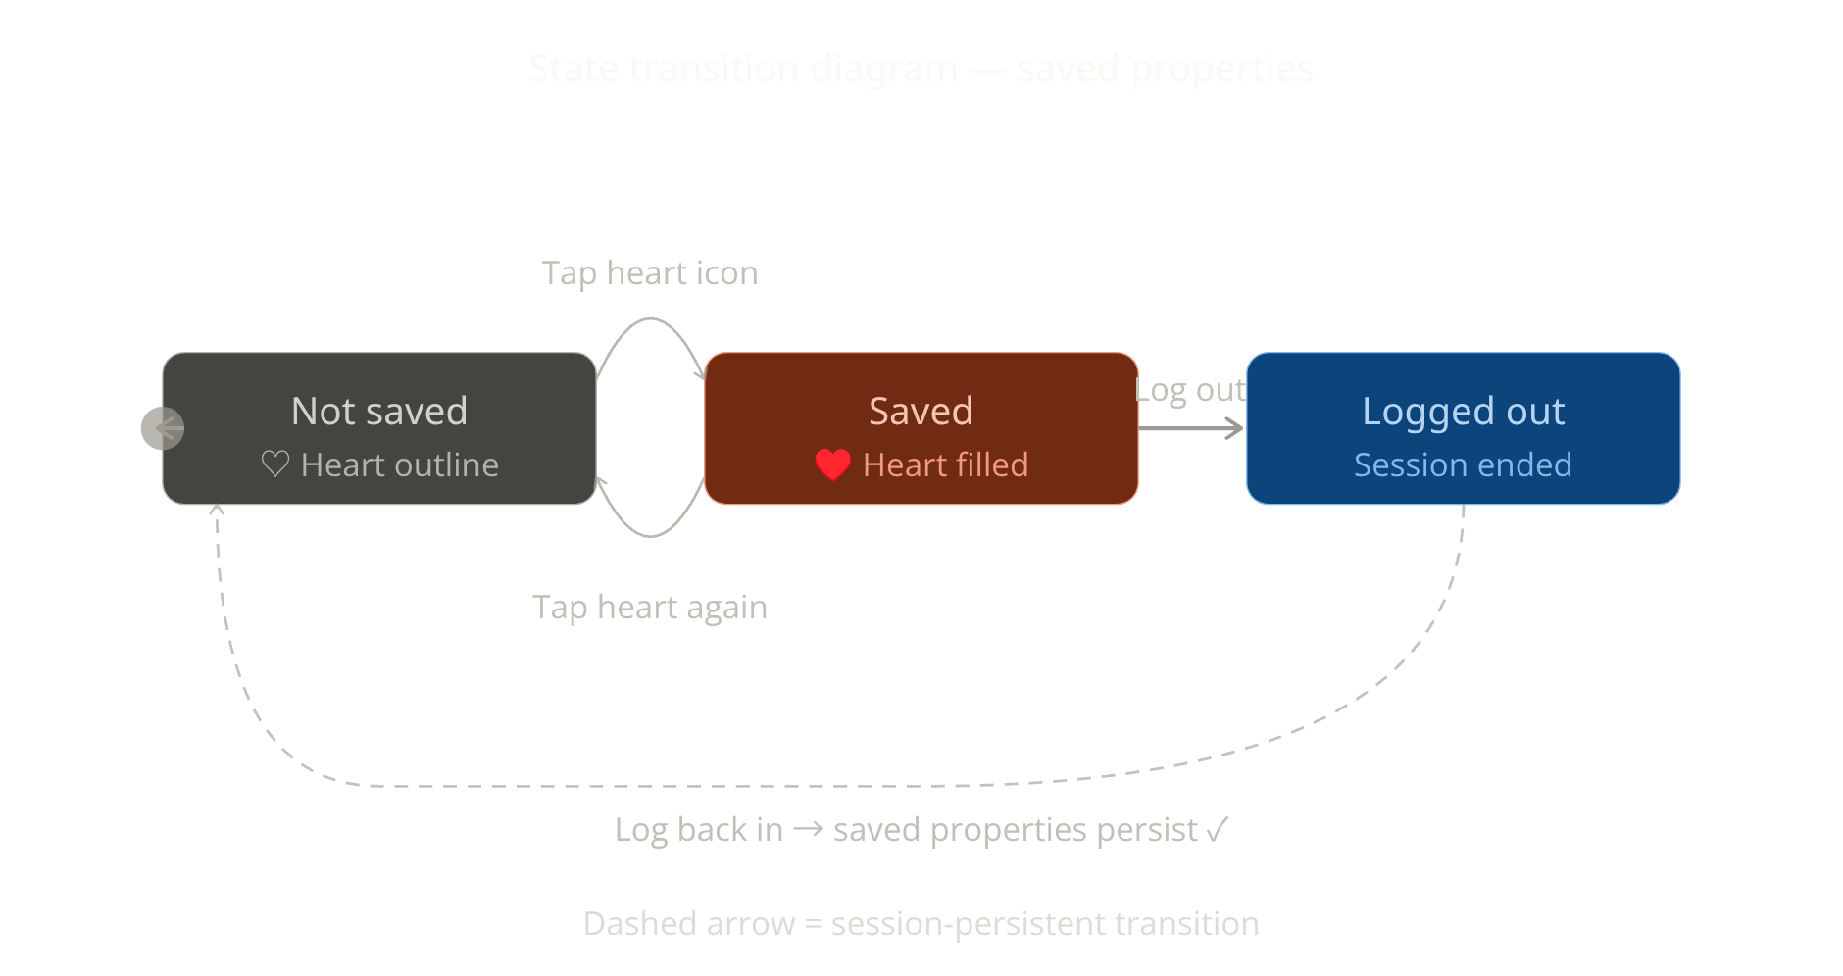
Black Box Testing: State Transition
Applied to: User Account – Saved Properties
Not Saved
Saved
Removed
Initial state
Click heart icon
Click heart again
Transitions Tested
Click heart icon → Property saved
Click heart again → Property removed
Log out → Saved properties persist (remembered)

Slide 11




Integration Testing
We tested how features work together, not in isolation
Search bar + Filter
Login → Saved Properties
Mortgage Calculator
Working together
Appearing after login
Connected to listing price (auto-fill)
Approach: Bottom-Up

Slide 12
Integration Testing
We tested how features work together, not in isolation
Search bar + Filter
Login → Saved Properties
Mortgage Calculator
Working together
Appearing after login
Connected to listing price (auto-fill)
Approach: Bottom-Up

Slide 13
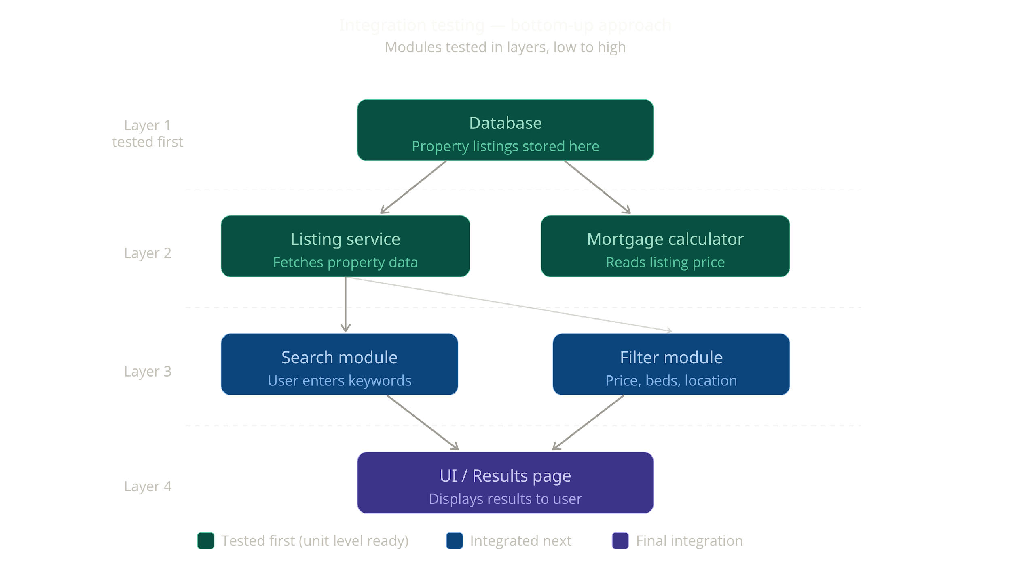

Slide 14
System Testing
Tested the full app end-to-end like a real user
01
02
Search for a 2-bed apartment in Dubai Marina
Contact agent form
Correct results shown
Message sent successfully
03
04
Register new account
Mobile app vs web
Verification email received
Same search, same results?

Slide 15
System Testing
Tested the full app end-to-end like a real user
01
02
Search for a 2-bed apartment in Dubai Marina
Contact agent form
Correct results shown
Message sent successfully
03
04
Register new account
Mobile app vs web
Verification email received
Same search, same results?

Slide 16
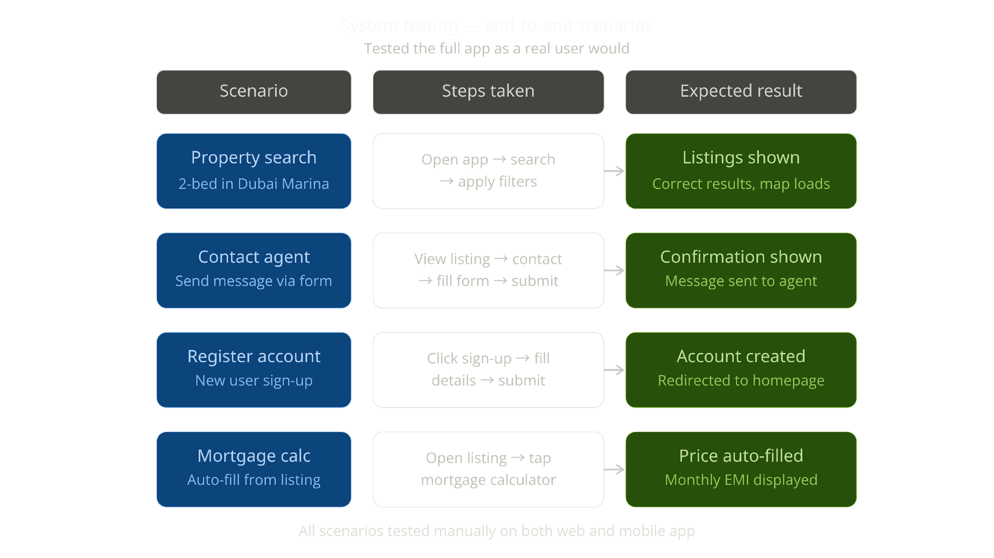

Slide 17
Test Cases Summary
Testing Level
Technique
No. of Test Cases
Unit (White-box)
CFG / Basis Path
3
Black-box
ECP
4
Black-box
BVA
6
Black-box
Decision Table
4
Black-box
State Transition
4
Integration
Bottom-Up
5
System
End-to-End
6
Total
32

Slide 18
Defects Found
#
Feature
Bug
Severity
1
Bedroom filter
Crash when Studio (0) selected
High
2
Saved properties
Heart icon unresponsive on slow network
Medium
3
Login
No error shown if email field is empty
Low
4
Mortgage calc
Accepts negative interest rate
Medium

Slide 19

Lessons Learned
Testing even simple features reveals real bugs
Boundary values are where most bugs hide
State transition helped us think like real users
Manual testing takes time but teaches you to observe carefully
We learned that no app is bug-free, even a top platform like Bayut has gaps

Slide 20

Conclusion & Q&A
32
4
Test Cases
Defects Identified
Designed and executed manually
With clear severity levels
We successfully applied all testing levels to Bayut UAE. Testing improved our understanding of the app's quality.
Thank You
Questions?

